Slide 1
Multi-Genre Feature Articles
Prepared by M. MacDonald BJH

Slide 2
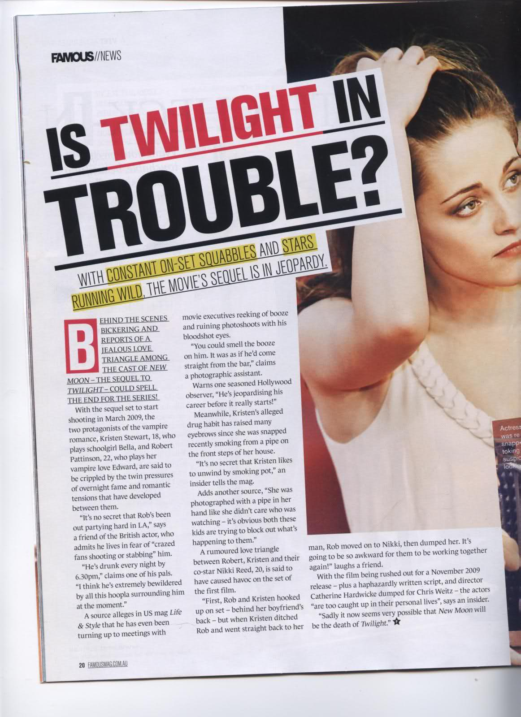
Magazine Articles
Articles inform, entertain, and even persuade
They may simply satisfy the reader's curiosity about a particular topic
They may provide more information about an important issue
They may offer an opinion about an issue
They may present a personal or humorous perspective on life

Slide 3
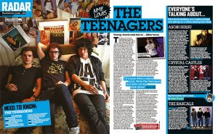
Magazine Articles
Articles require you to be able to grab the reader's attention quickly and hold that attention
Article writers go beyond just the facts on the surface and add colour, detail, background and personal comment.
The appeal of feature articles is usually the personal perspective of the writer

Slide 4
Magazine Articles: Main Characters
Profiles or interviews with the main character (s)
Humorous reflections based on the characters personal experiences in the novel.
Descriptions of important events in the story—accidents, deaths, life-threatening situations, heroic actions, etc.

Slide 5
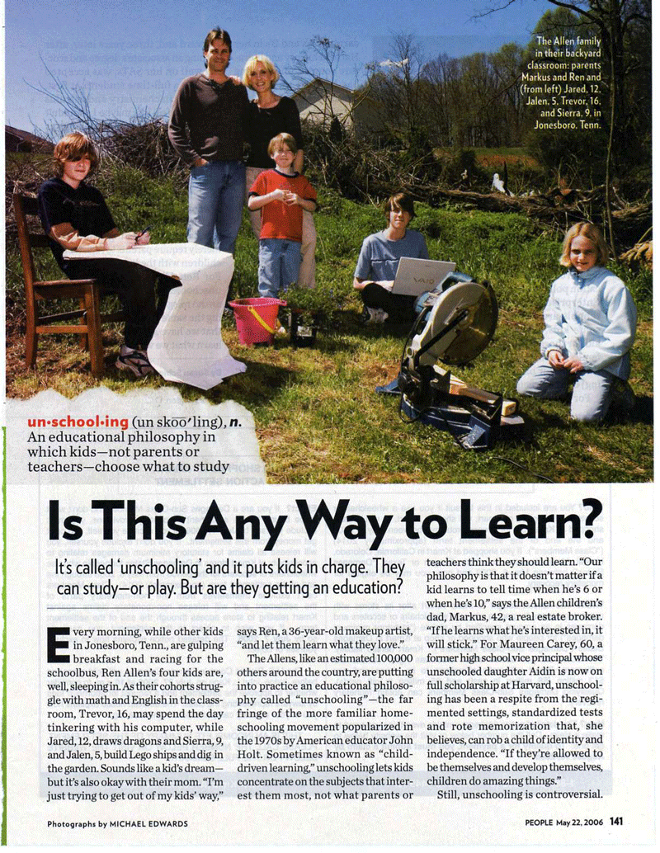
Magazine Article: Structure
A feature article follows a
standard structure and
should always include the
following:
headline
introduction
main body
concluding paragraph

Slide 6
Magazine article: Headlines
The headline is what will attract the reader’s attention, so it needs to be written as a large bold-print title.
Most headlines give clues to the story’s content.
A clever headline will draw more readers to your article

Slide 7
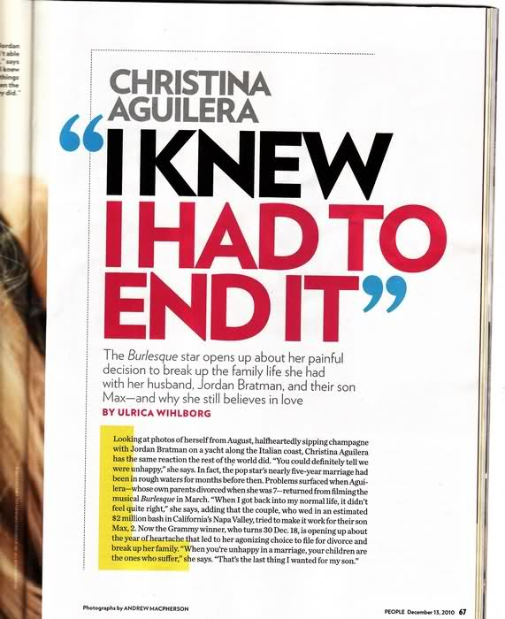
Magazine Articles: Introduction
The first paragraph introduces the
subject or theme of the article
It should capture the reader's interest by :
including an unusual or shocking statement
Providing background information
Heightening the drama of an event or incident—effective emotional description
Create a relationship between the writer and the reader—casual relaxed or confrontational
Establish the writer's tone and relationship with the subject and reader—writer’s attitude is important

Slide 8
Magazine Article: Main Body
Consists of a number of paragraphs
that expand the main topic of the
article.
The usual components are:
dings.
Personal viewpoints
Character quotes and interviews
Personal experiences and stories.
Specific names, places, events and dates
Photographs, tables, diagrams and graphs.

Slide 9
Magazine Article: Concluding Paragraph
The concluding paragraph
should leave a lasting
impression
Typical Ideas:
Strong quotation that summarizes the main idea (s)
Interesting final thought about the subject /main ideas of the article
A call to action—asks the reader to do something about the subject/concepts discussed in the article

Slide 10
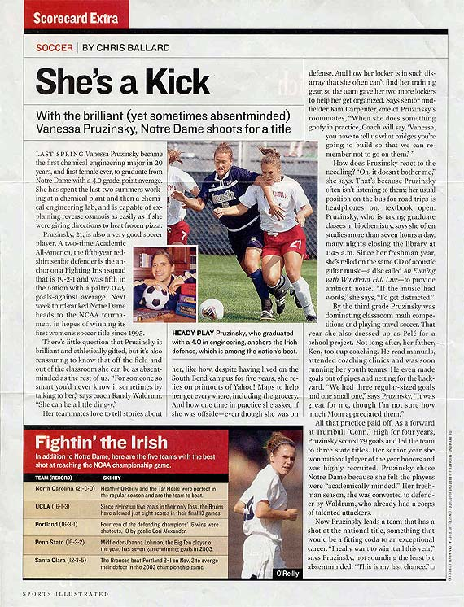
Magazine Articles: Language
The writer writes in a personal tone
Personal stories help to maintain reader interest.
Exaggeration is sometimes used to heighten humour.
Asking questions help to involve the reader
Emotional words are used to evoke a personal response in the reader
Effective use of imagery and description engage the reader's imagination.
The use of direct quotes personalizes the topic.

