Slide 1
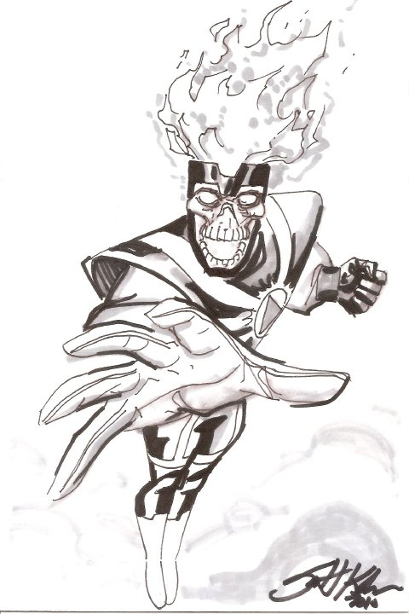
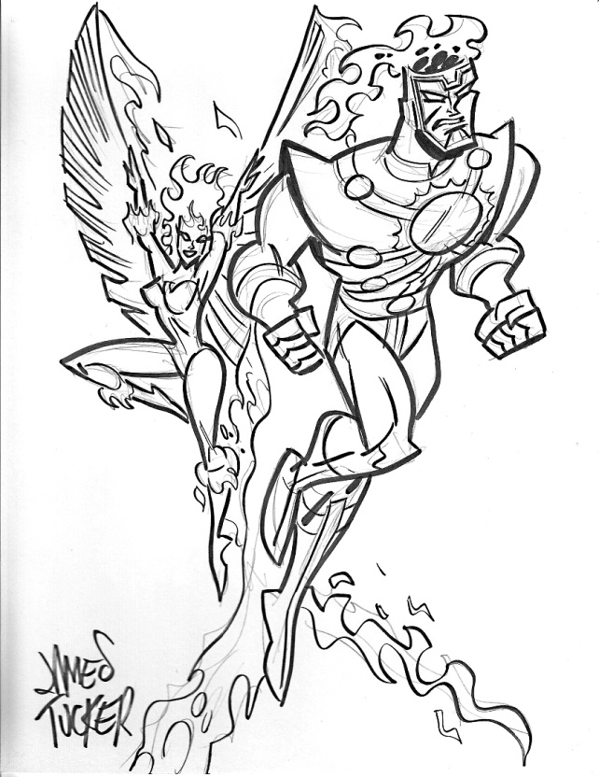
Cartoons and Graphic Narratives
Creating a one-page narrative
M. MacDonald BJH

Slide 2
The storyline: Introductory Panels
First Panel is the name of the cartoon.
The second panel introduces the setting.
Note: Wide shot
The third panel introduces the two main characters.
Note: Close-up and facial expressions
Dialogue is very short

Slide 3
Introducing Conflict and Suspense
Panels four is a transition to the main conflict or problem
Note: The close-up and facial expression
Panel Five conveys the conflict and creates suspense
Note: the facial reaction and the word crunch to help show discomfort.
Panel six shows that the other character is unaware of the problem
Suspense is created—how will the two react? What will they do to resolve the situation?

Slide 4
Creating a interesting conclusion
Panel seven establishes the source of the conflict
Note: the facial features show that conflict is still unresolved
Panel eight shows the irony and humor of the situation
“Be considerate of others”
“Please no talking during the show”
Panel Nine shows an edit—where the facial expression needs to be changed to reflect the dialogue.
“Shh…you wanna get us kicked out?
Note: the conflict is not resolved at this point.
Note: The cut-off shot of the inconsiderate big guy and his friend still unaware of the problem.

Slide 5
Character Transformation

Slide 6
Final Draft

